Slide 1
OOP Object Oriented Programming
Mohamed Ehab

Slide 2


Mohamed Ehab
ITI Certification
Vice Head Flutter GDG Benha
Core Team Flutter GDG Benha
Certified Flutter developer from ITI 2024
Current Season 2024-2025
Last Season 2023-2024

Slide 3
BootCamp Roadmap
Day 1
Day 3
Day 5
Day 2
Day 4
Day 6
Flutter Introduction & Layout Widgets
Dart Basics
Chat app
OOP
Calculator
Competition

Slide 4
What is OOP ?

Slide 5
Object-oriented programming (OOP):- is a programming method that uses objects and their interactions to design and program applications. It is one of the most popular programming paradigms and is used in many programming languages, such as Dart, Java, C++, Python, etc.
In OOP, an object can be anything, such as a person, a bank account, a car, or a house. Each object has its attributes (or properties or Fields) and behavior (or methods). For example, a person object may have the attributes name, age and height, and the behavior walk and talk.

Slide 6
OOP Advantages
It is easy to understand and use.
It increases reusability and decreases complexity.
The productivity of programmers increases.
It makes the code easier to maintain, modify and debug.
It promotes teamwork and collaboration.
It reduces the repetition of code.

Slide 7
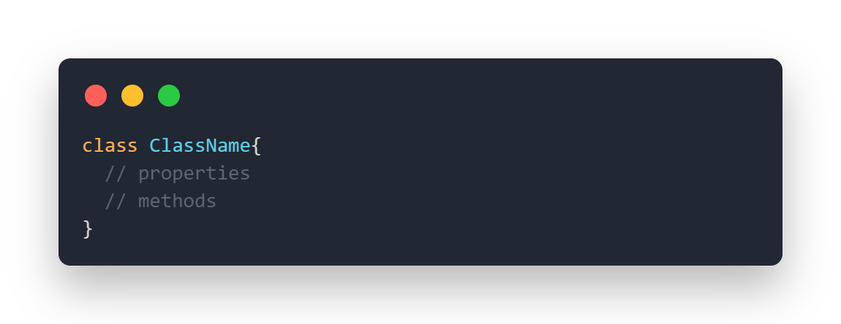
Class
In object-oriented programming, a class is a blueprint for creating objects. A class defines the properties and methods that an object will have. For example, a class called Person might have properties like name, age and methods like eat, walk.
Declaring class in OOP :-
You can declare a class in dart using the class keyword followed by class name and braces {}.
Syntax :-

Slide 8
The class keyword is used for defining the class.
ClassName is the name of the class and must start with capital letter.
Body of the class consists of properties and functions.
Properties are used to store the data. It is also known as fields or attributes.
Functions are used to perform the operations. It is also known as methods.

Slide 9
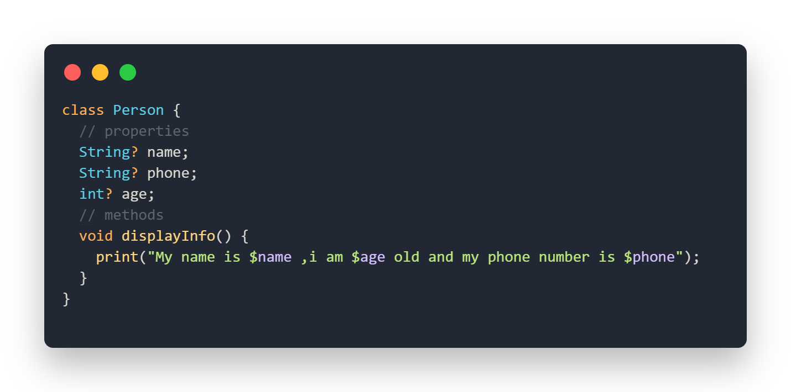
Class Example

Slide 10
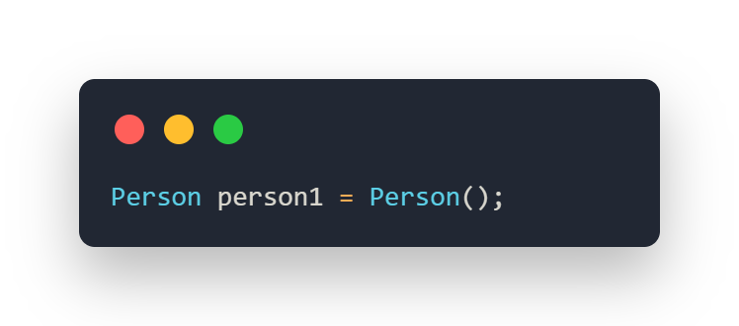
Object
In object-oriented programming, an object is a self-contained unit of code and data. Objects are created from templates called classes. An object is made up of properties(variables) and methods(functions). An object is an instance of a class.
Declaring object in OOP :-
ClassName objectName = ClassName();
Syntax :-

Slide 11
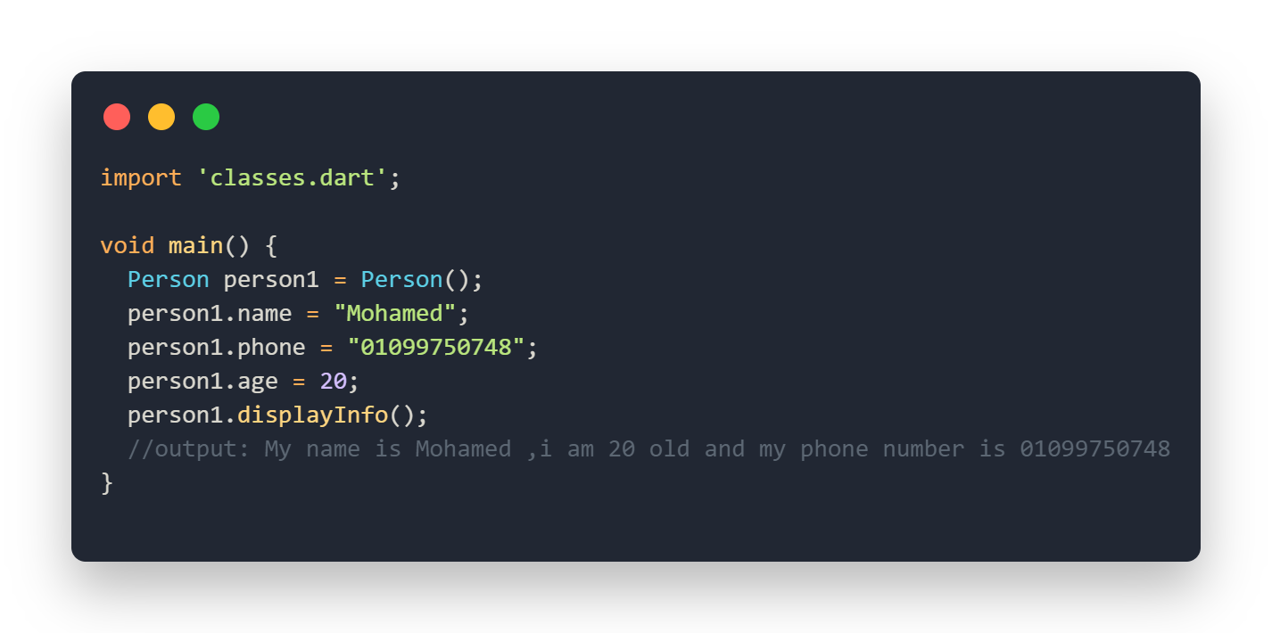
Object Example

Slide 12
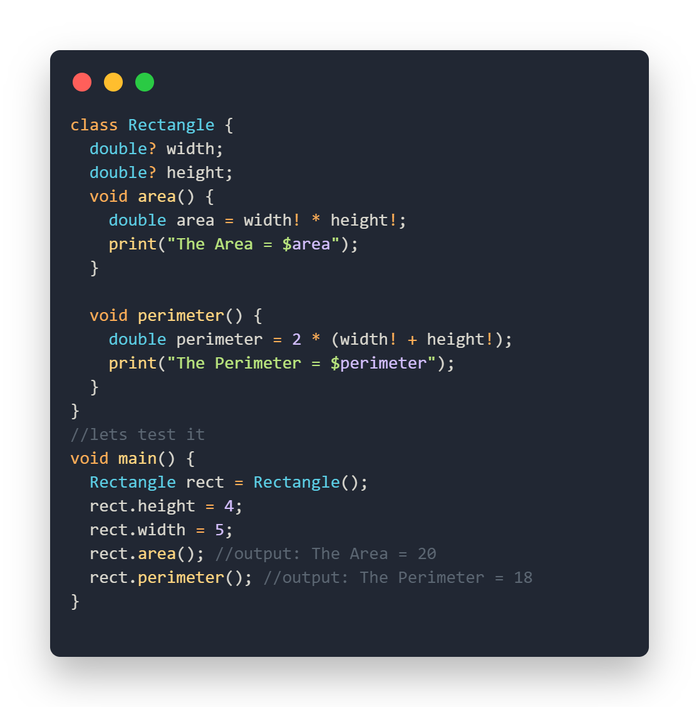
Make a Rectangle class and declare width and height as attributes and make two methos to calculate area and perimeter

Slide 13
Constructor
A constructor is a special method used to initialize an object. It is called automatically when an object is created, and it can be used to set the initial values for the object’s properties.
The constructor’s name should be the same as the class name.
Constructor doesn’t have any return type.
Constructor is only called once at the time of the object creation.

Slide 14
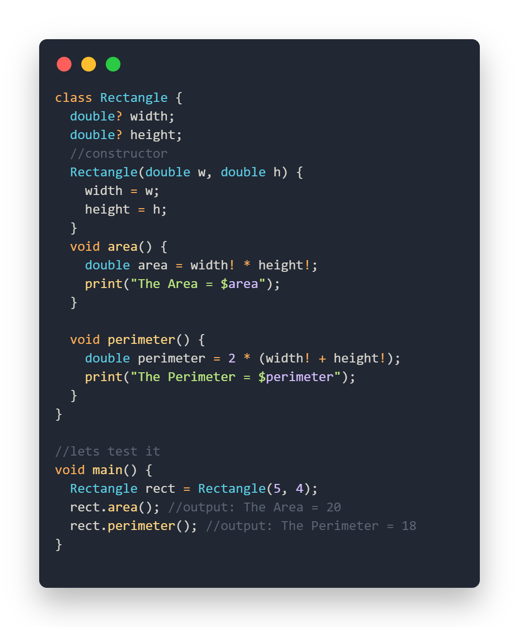
Rectangle Example with constructor

Slide 15
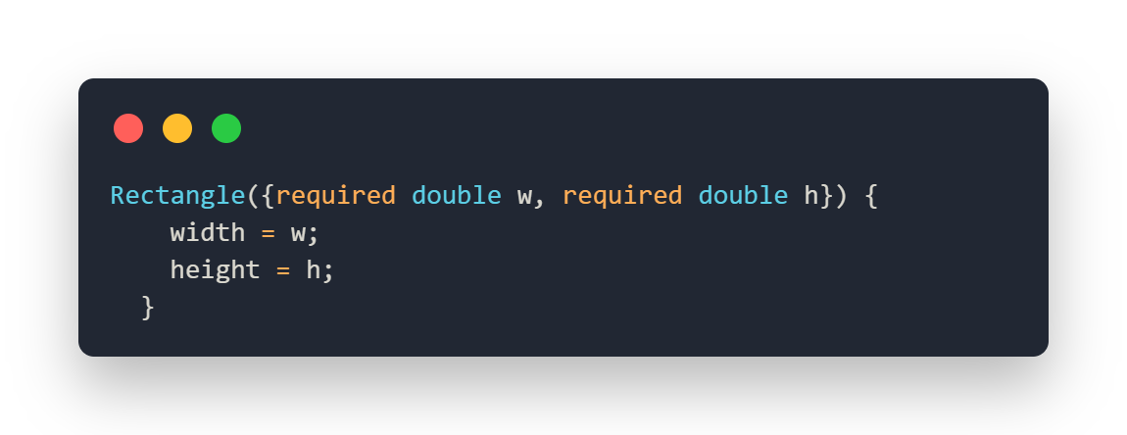
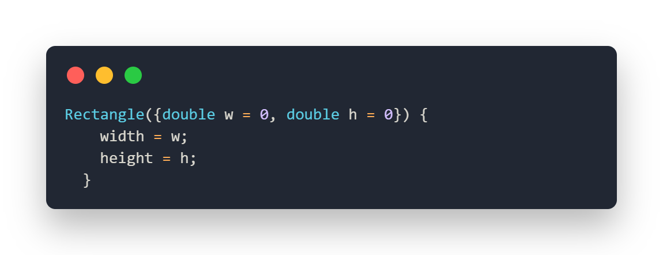
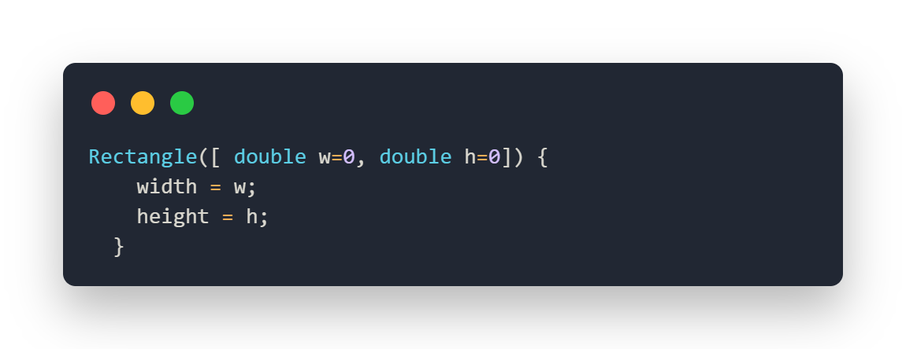
Named Required Parameter Constructor
Named Optional Parameter Constructor
Optional Positional Parameter Constructor

Slide 16
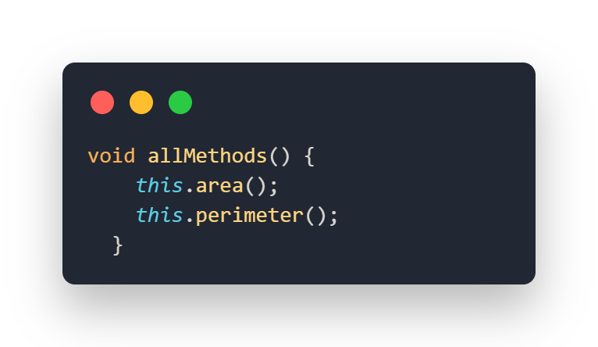
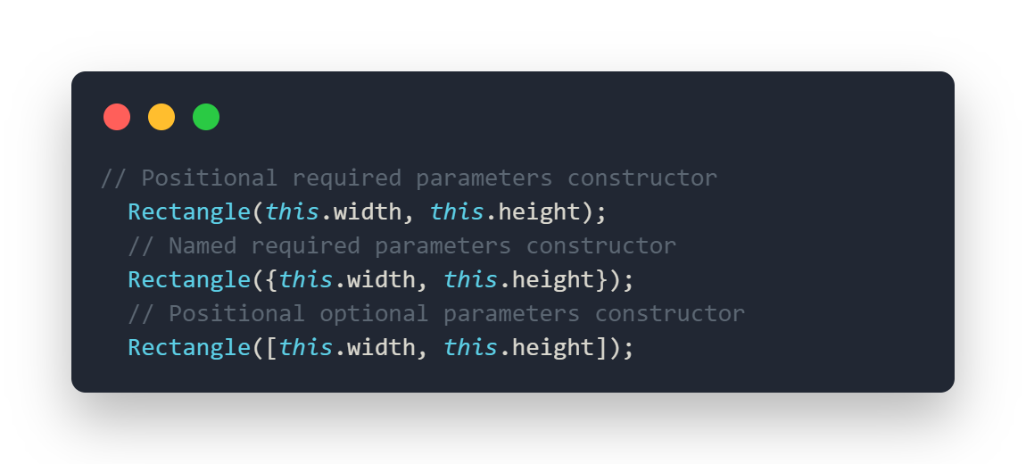
This keyword🤔
This keyword is used to refer to the current instance of a class. It provides a way to access members (attributes and methods) of the current object from within the class itself.
Access parameter by this keyword
Access Methods by this keyword

Slide 17
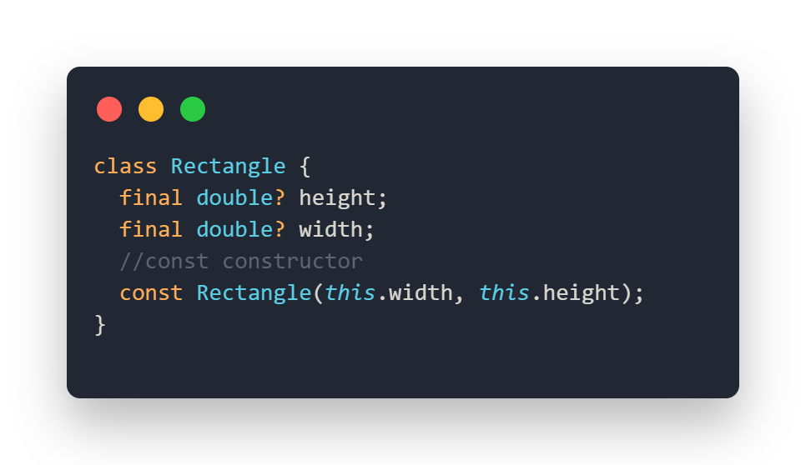
Const Constructor
const constructor is a special type of constructor that allows you to create compile-time constant instances of a class. The key feature of a const constructor is that the object it creates is immutable (its fields cannot be changed after the object is created) and can be reused across the program, leading to memory and performance optimization.
All fields must be final
does not have a body

Slide 18
What is overloading ?

Slide 19
Named Constructor
Named constructors are a way to define additional constructors for a class. Named constructors are helpful when you need multiple ways to create objects of a class, each with its own initialization logic.
Declaring Named Constructor in OOP:-
is defined using a dot (.) after the class name, followed by the constructor's name.

Slide 20
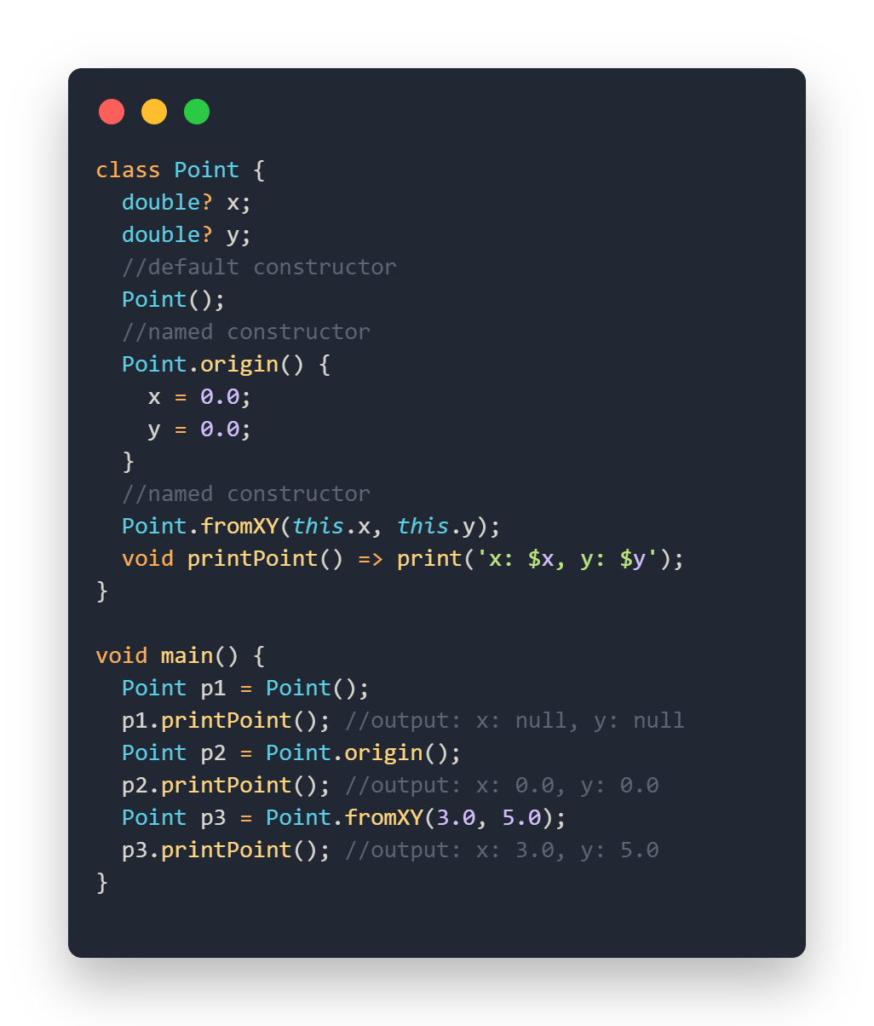
Example of Named Constructor

Slide 21
Key Principles of OOP
Encapsulation
Inheritance
Abstraction
Polymorphism
01
02
03
04

Slide 22
What is Encapsulation

Slide 23
01
Encapsulation
The concept of restricting (تقييد) access to certain details of an object and exposing only the necessary parts.
In Dart Encapsulation means hiding data within a library (file), preventing it from outside factors, but in some language like c++ hiding data within a class.
How to implement Encapsulation:-
We need to declare the class properties private by using underscore(_) before attribute name.
Providing public getter and setter methods to access and update the value of private property (getter to access and setter to update the private property).

Slide 24
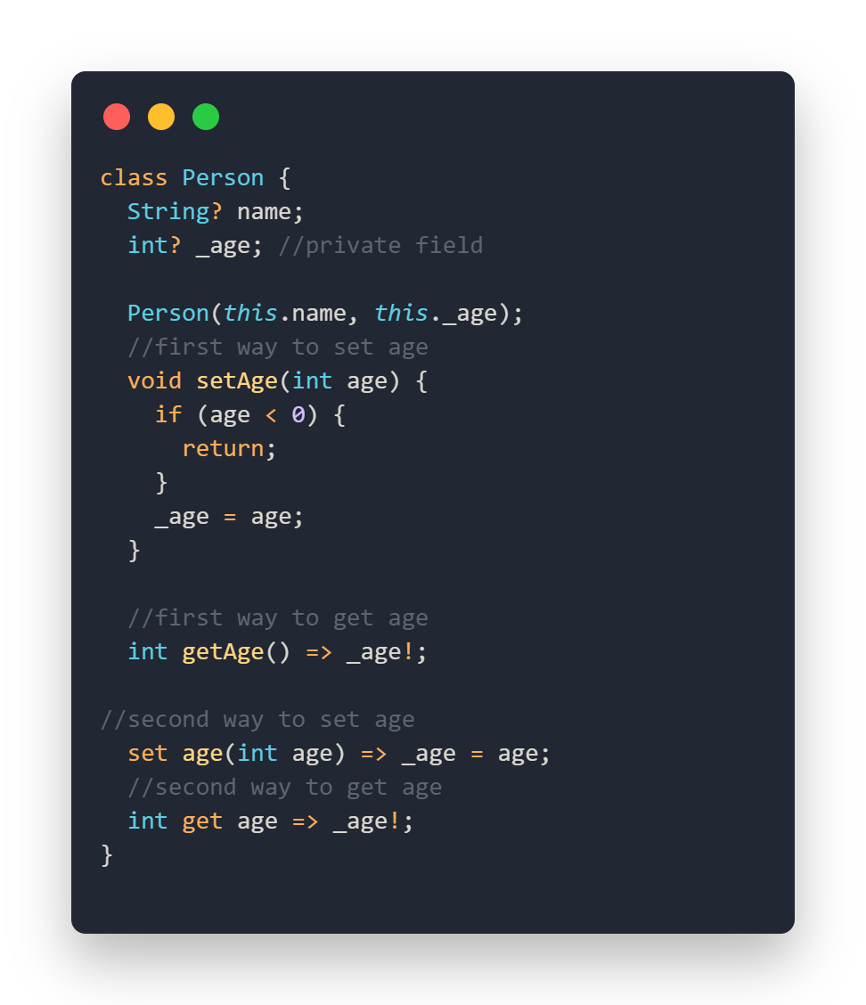
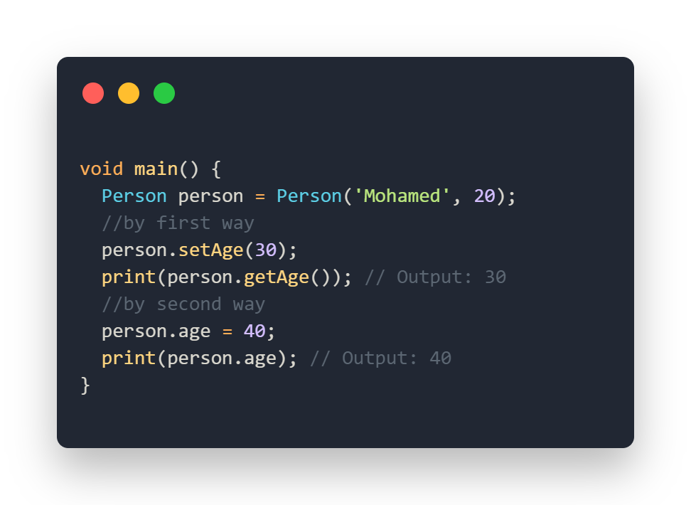
Encapsulation example

Slide 25
What is Inheritance

Slide 26
02
Inheritance
A mechanism for creating a new class based on an existing class, inheriting its properties and methods.
Parent (super) class : it is the class whose properties are inherited by the child class
Child (sub) class : it is the class that inherits the properties of the other classes
Types of Inheritance:
Single Inheritance: This inheritance occurs when a class inherits a single-parent class.
Multi-Level Inheritance: This inheritance occurs when a class inherits another child class.
Hierarchical Inheritance: More than one classes have the same parent class.
Multiple Inheritance: This inheritance occurs when a class inherits more than one parent class. Dart doesn’t support Multiple Inheritance .

Slide 27
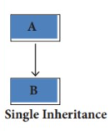
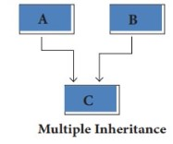
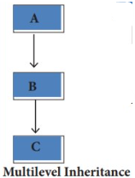
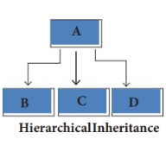

Slide 28
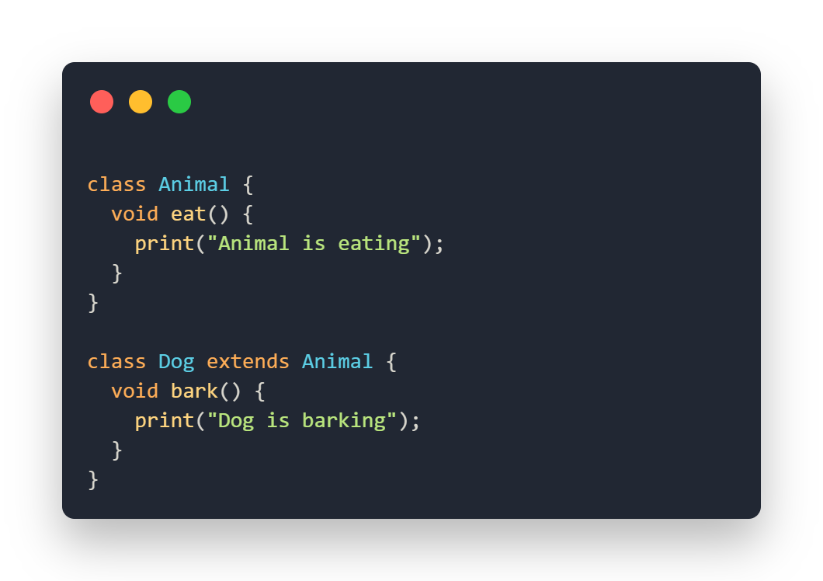
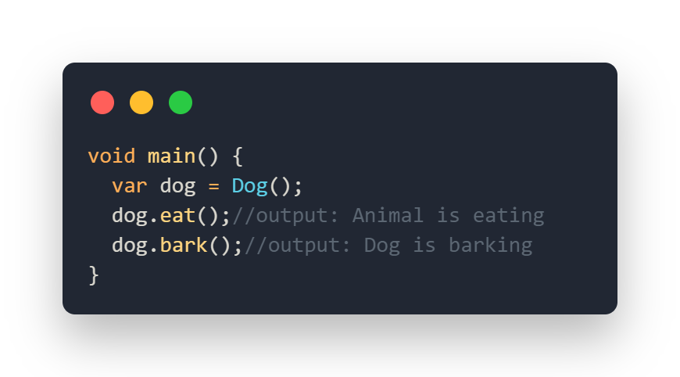
Single Inheritance Example

Slide 29
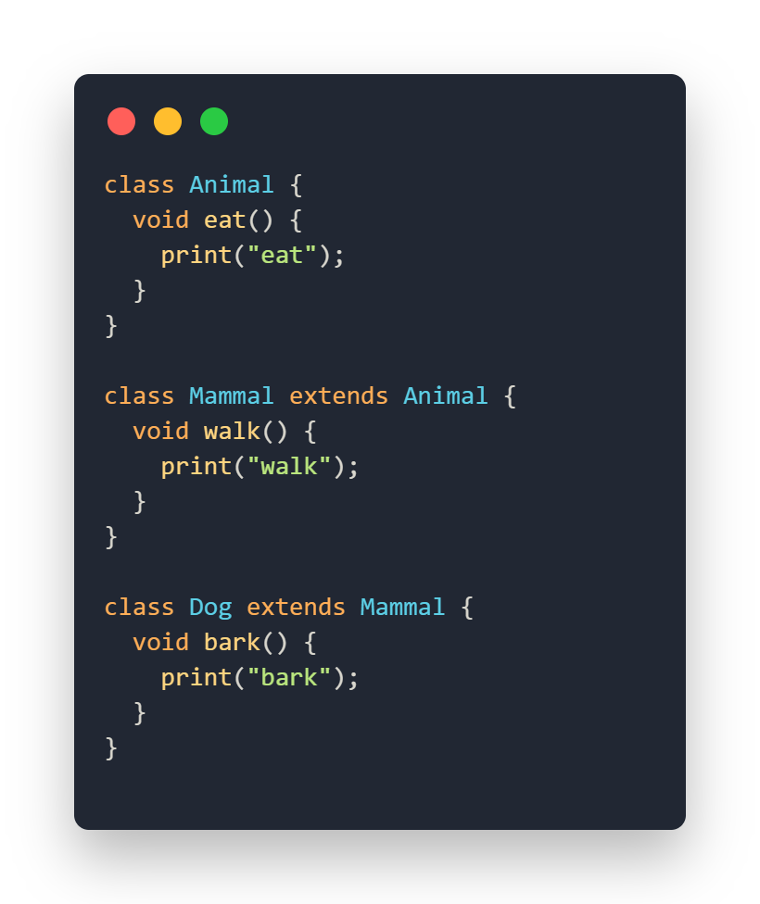
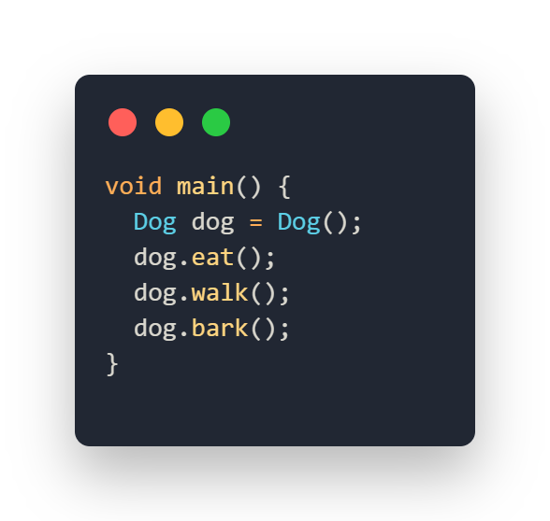
Multilevel Inheritance Example

Slide 30
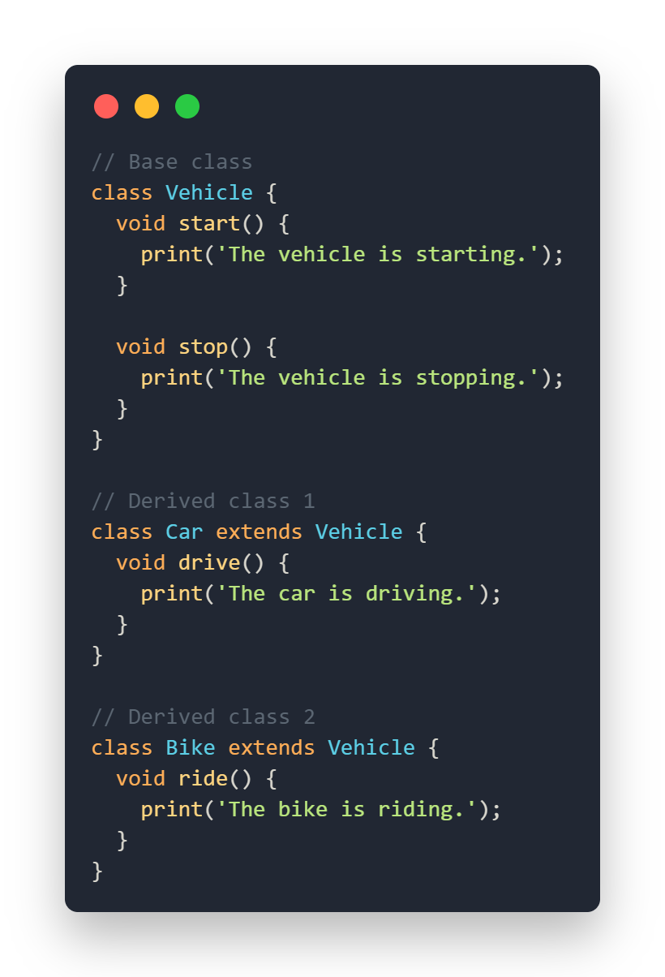
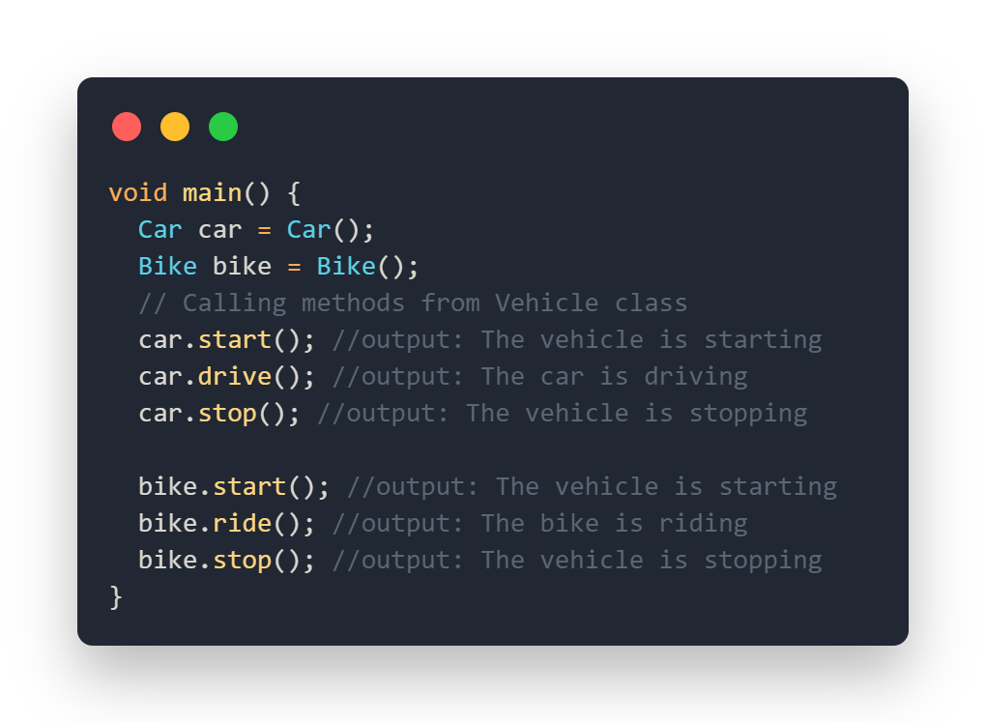
Hierarchical Inheritance Example

Slide 31
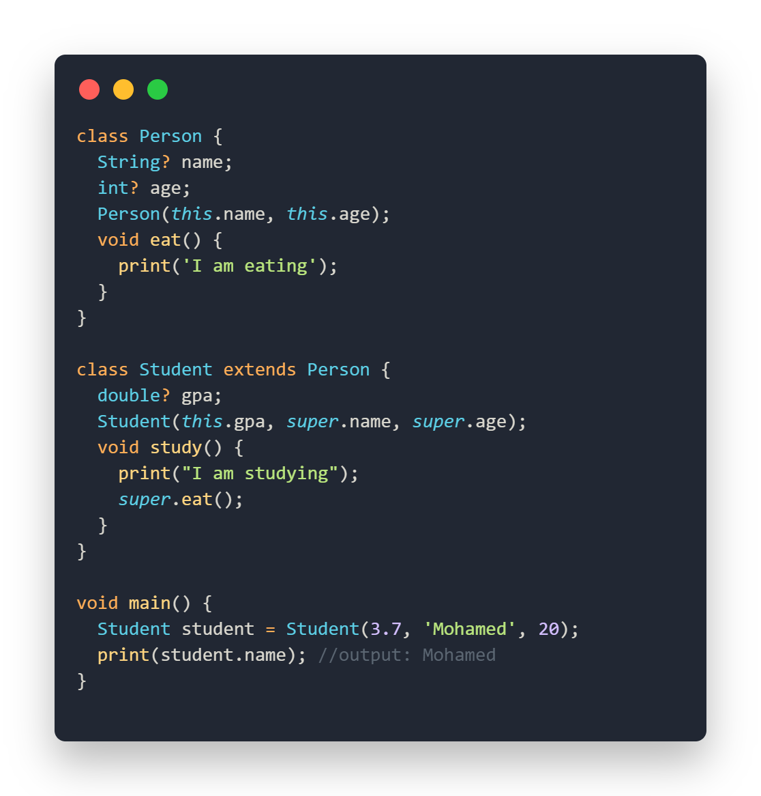
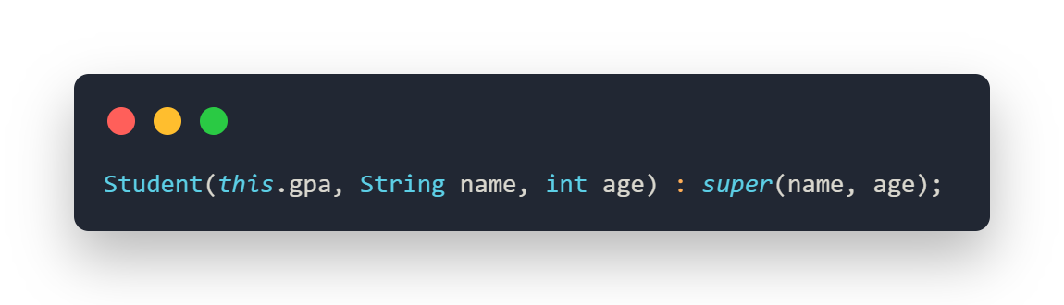
Super keyword🤔
This keyword is used to refer to the parent class. It provides a way to access members (attributes and methods) of the parent class.
Another way for this line

Slide 32
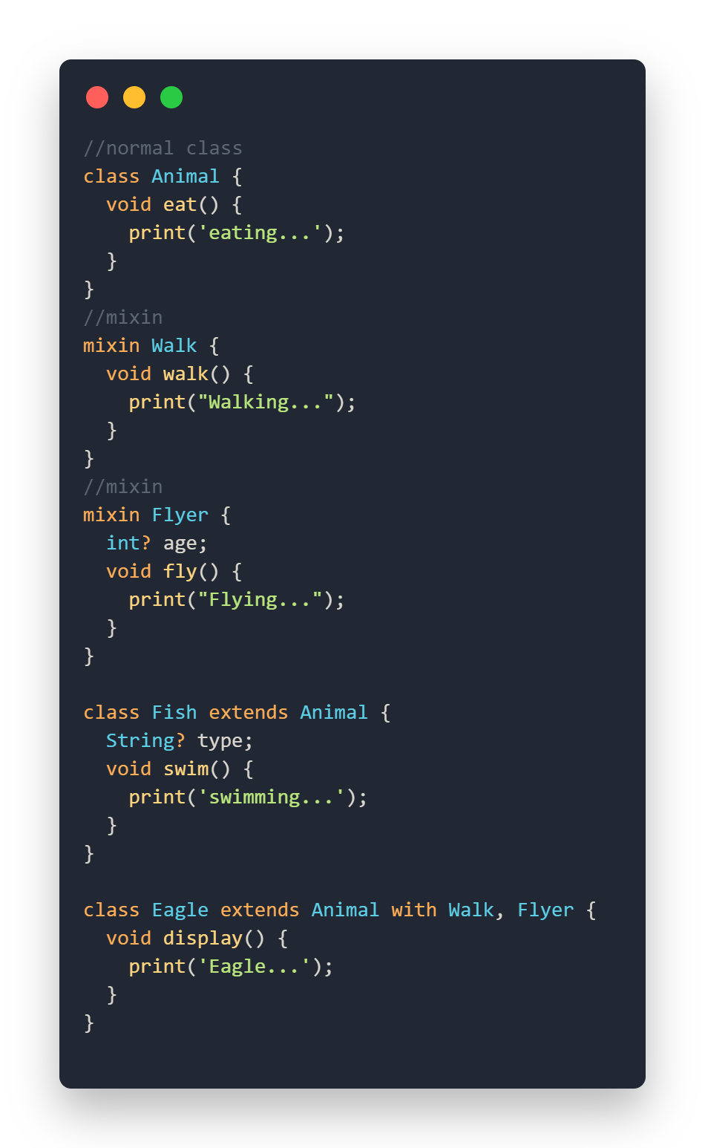
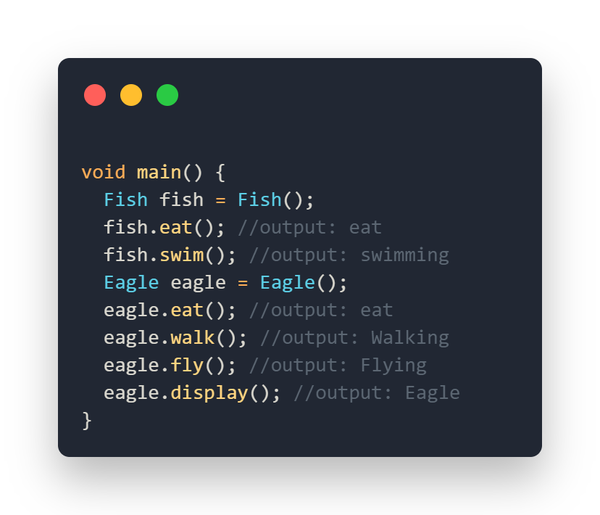
Mixin
Mixins are a way to reuse a class's code in multiple class hierarchies, solving the problem of multiple inheritance. They allow you to add functionality to classes without using inheritance.
Key Characteristics:
Cannot be Instantiated
Mixins do not have constructors
A class can use more than one mixin by using the with keyword

Slide 33
What is Abstraction

Slide 34
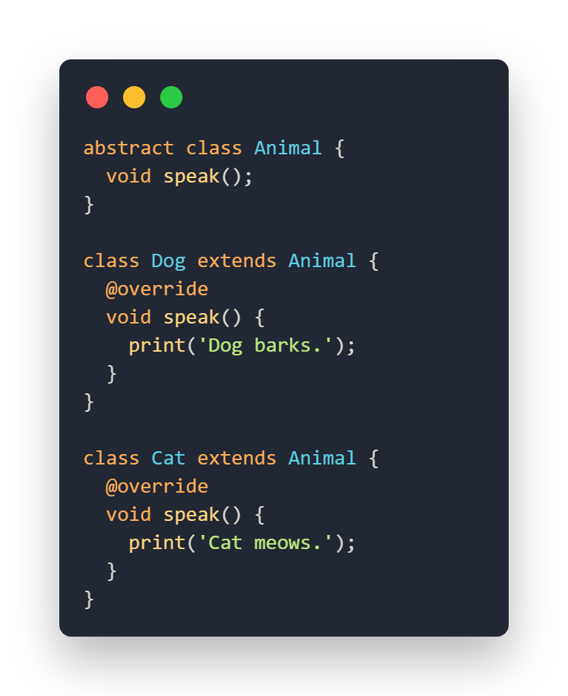
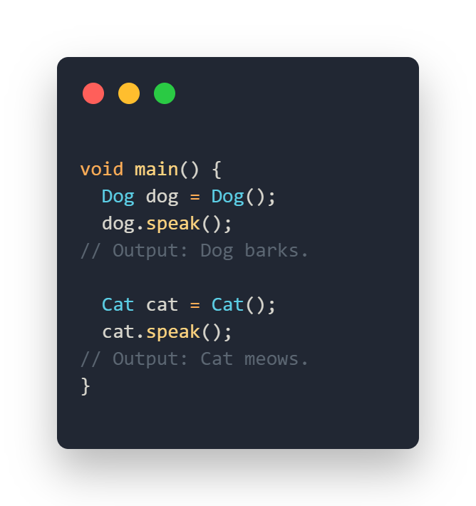
03
Abstraction
Abstraction is the process of hiding complex implementation details , showing only the essential features of an object and cannot be instantiated and may contain abstract methods (methods without body). It helps in reducing programming complexity.

Slide 35
What is Polymorphism

Slide 36
04
Polymorphism
Poly means many and morph means forms.
Is the ability of an object to take many forms.
refers to the ability of objects of different classes to be treated as objects of a common superclass.
Ex: As human, we can take on many forms. we can be a student, a teacher, a parent, a friend and so on. The same in OOP

Slide 37
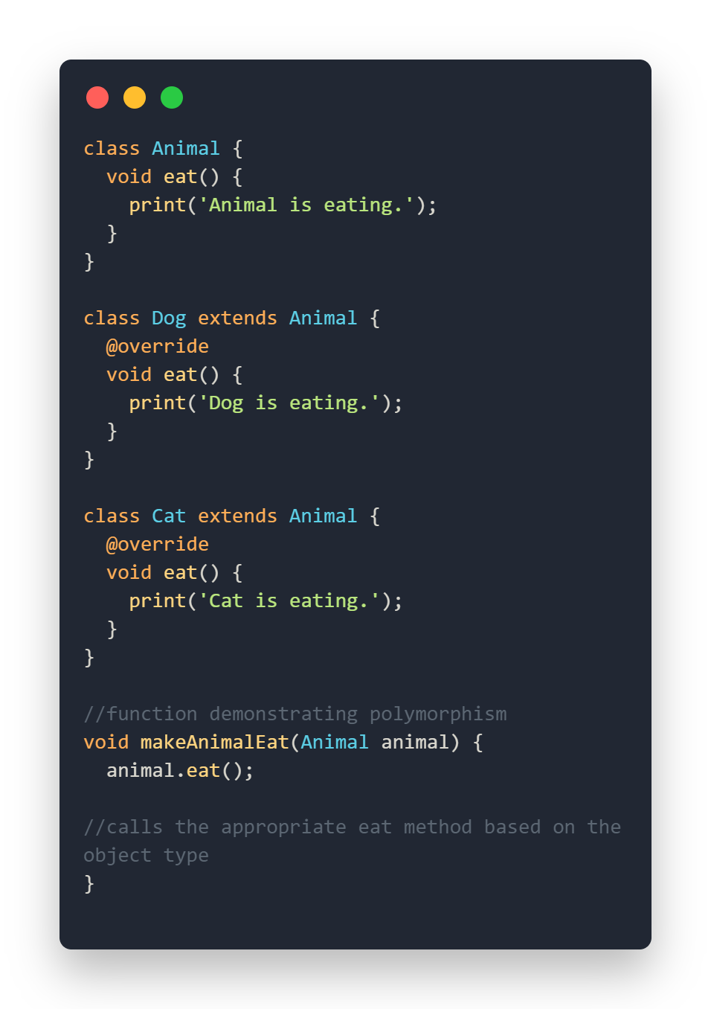
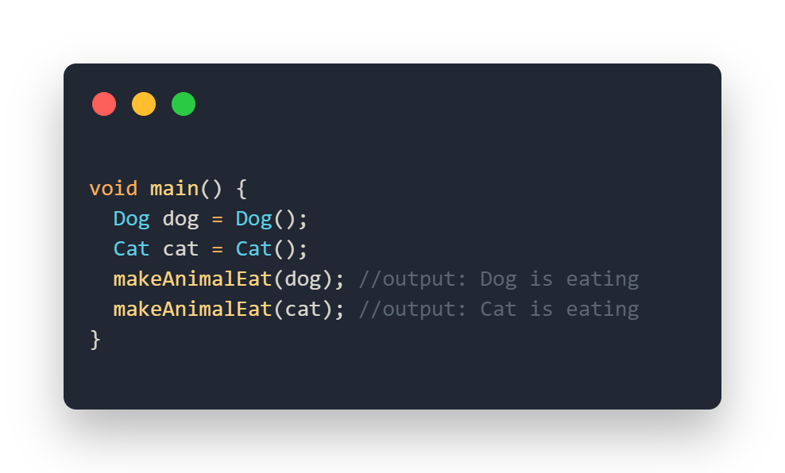
Example on Polymorphism

Slide 38


